Slide 1
به نام خدا
Indoor Positioning and Wayfinding Systems
Polwinno
سیدمحمدحسین حسینی
ارائه دهنده:

Slide 2
Contents
Classification of indoor nav/pos systems
BLE Based IPS
Evaluation Criteria

Slide 3
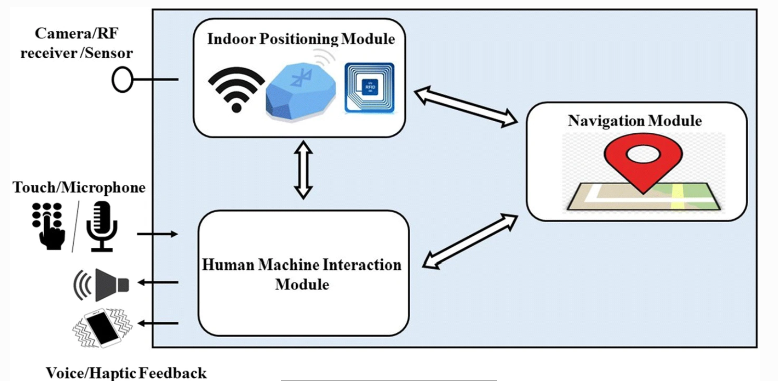
Classification of indoor nav/pos systems
Navigation and Positioning
Navigation
Map
Method for Route Planning
A* algorithm
Dijkstra’s algorithm
D* algorithm
Floyd’s algorithm
Indoor systems: General Diagram
Positioning Module
Navigation Module
HMI Module

Slide 4
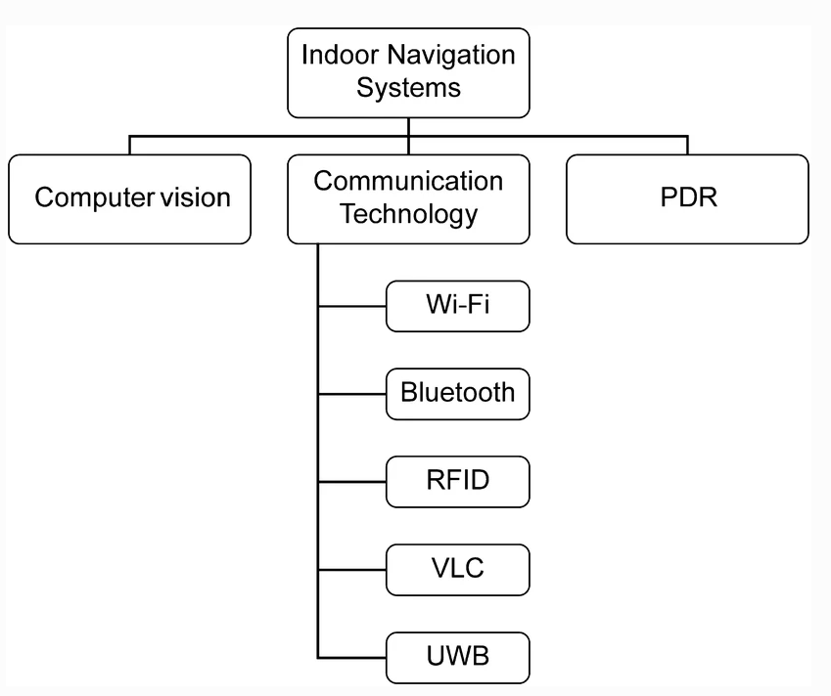
Classification of Systems
Computer Vision
Omnidirectional Cameras
3D cameras
Mobile Cameras
Various image processing algorithms
Speeded Up Robust Feature (SURF)
Gist features
Scale Invariant Feature Transform (SIFT)
Deep Learning Methodologies
CNN
KNN
Examples
Google Tango / Google Arcore
VINAV

Slide 5
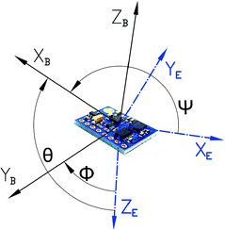
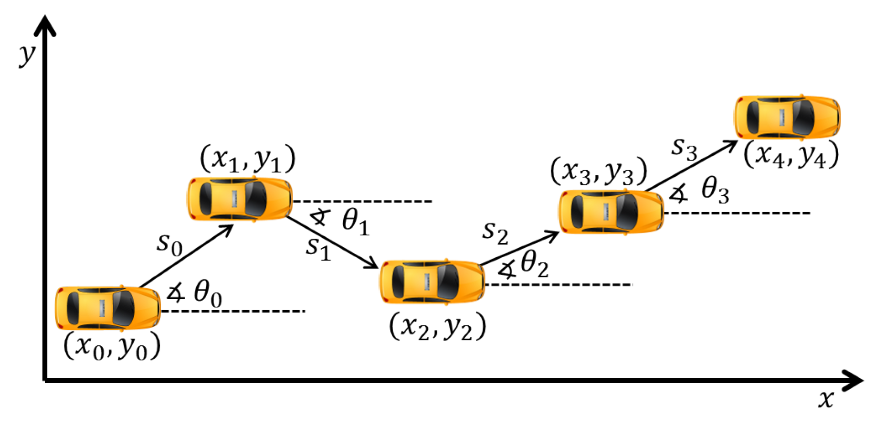
Pedestrian Dead Reckoning (PDR)
Accelerometers
Gyroscopes
Magnetometers
Errors due to the drift
Integrate with other technologies
Only PDR systems
calibration mark
accumulative errors

Slide 6
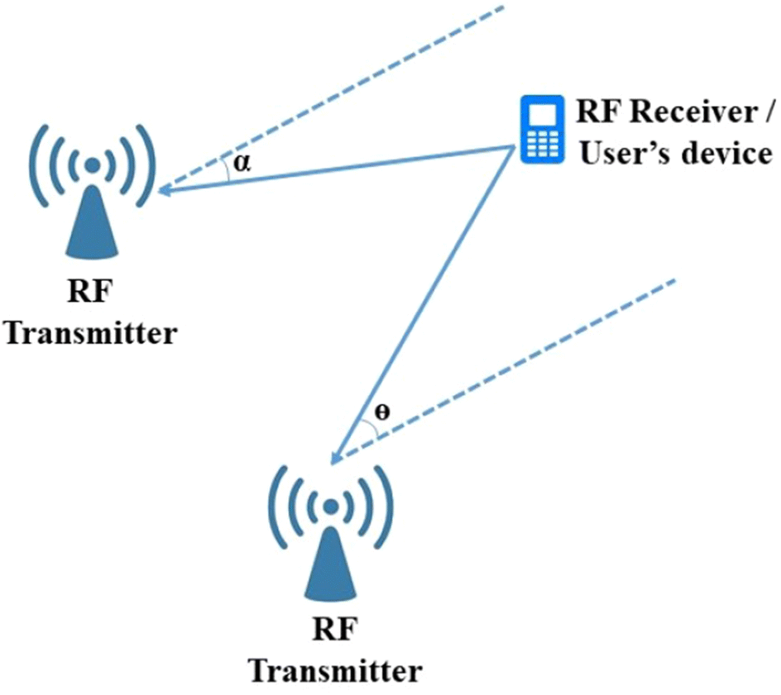
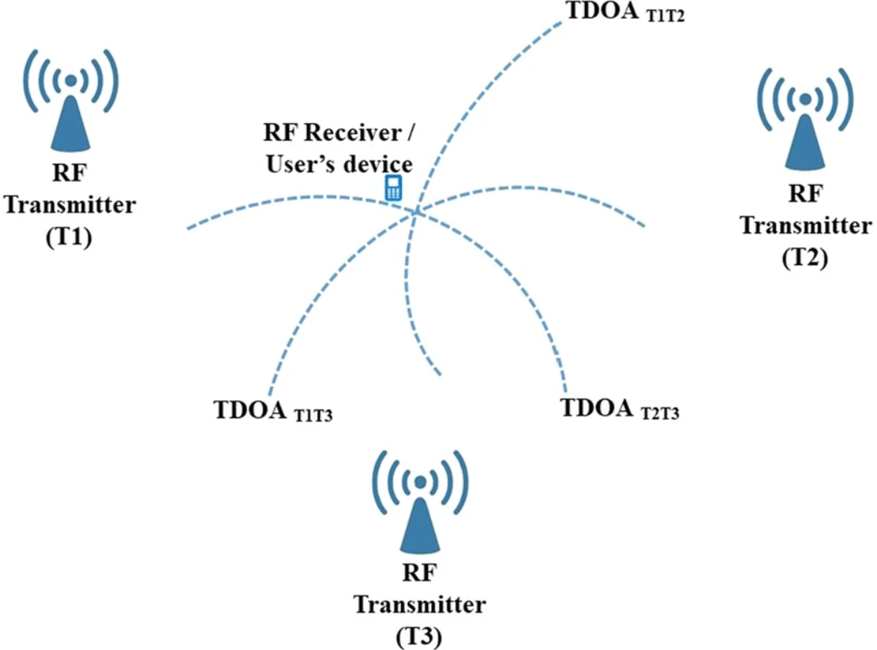
Communication Technologies
RFID
Received signal strength (RSS)
Angle of arrival (AOA)
Time of arrival (TOA)
Time difference of arrival (TDOA)
Trilateration
Fingerprinting
AOA
Wi fi
RSS fingerprinting
Trilateration
Triangulation
TDOA/trilateration
Examples
FreeNavi

Slide 7
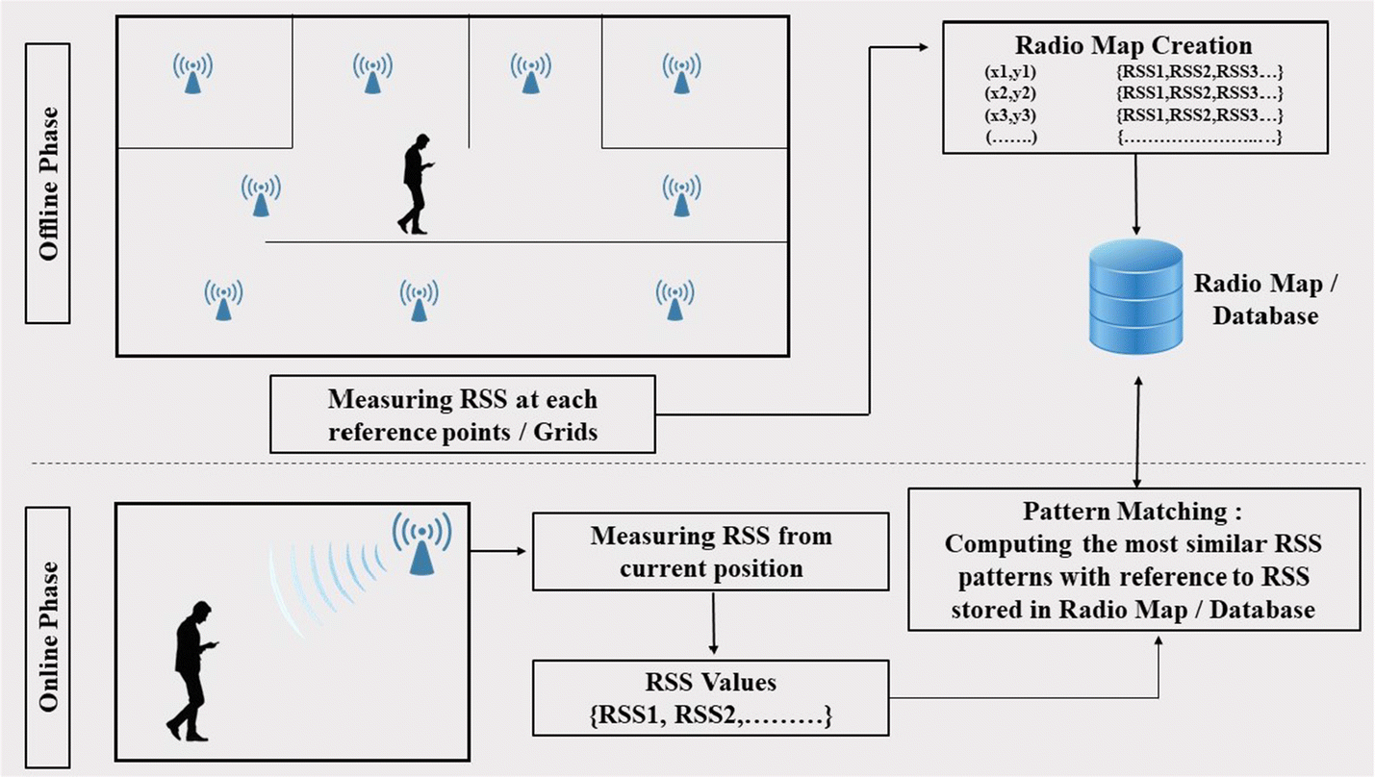
RSS Fingerprinting
BLE
Proximity sensing
RSSI Fingerprinting
BLE signals fluctuate by the time!
BLE and PDR
Inertial PDR for finding the attitude of robot
BLE RSS for localization / proximity
Both information fused to find update the location
BLE fingerprinting
linear regression method for feature extraction

Slide 8
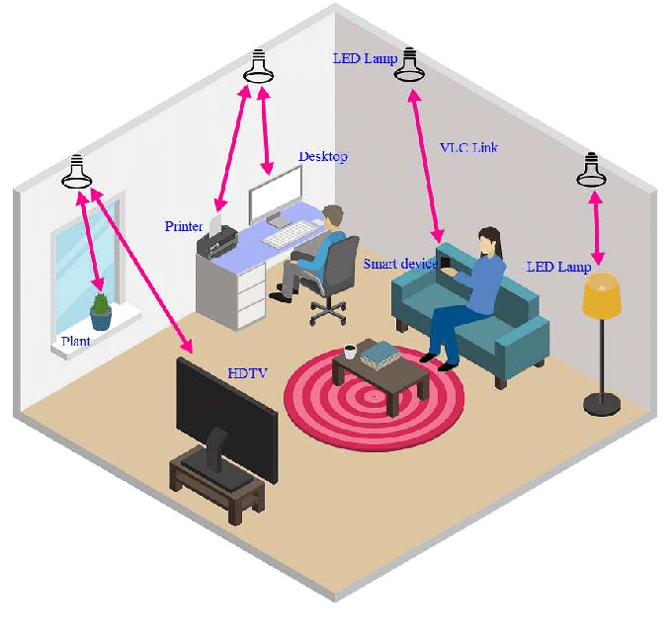

Visible Light Communication (VLC)
LEDs
Fluorescent lamps
latitude and longitude of each location stored as visible light ID
Ultra Wideband (BLE)
High Frequency
Time of Flight (TOF)

Slide 9
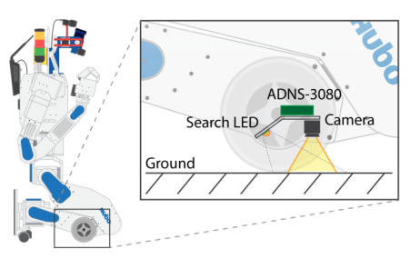
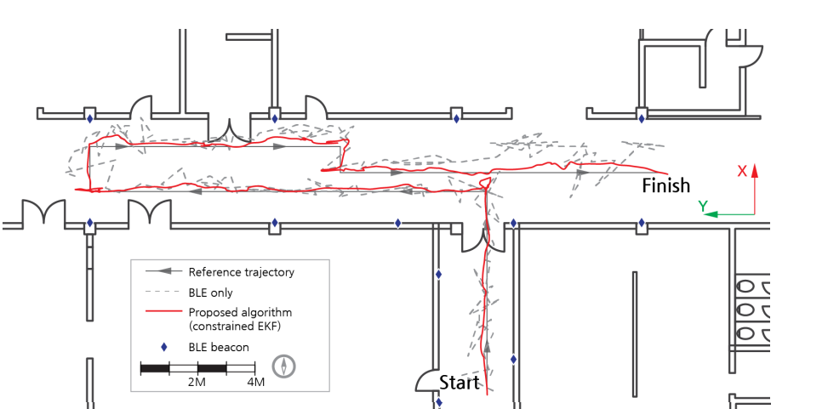
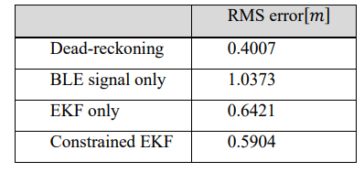
BLE Based IPS
Low cost positioning system using BLE and constrained EKF
Components
BLE
Magnetic field
Rate-gyro
Optical flow sensors
sensor fusion
Predicting with dead reckoning
Updating with BLE RSSI (triangulation)
Non linear system
Extended Kalman Filter
Results

Slide 10

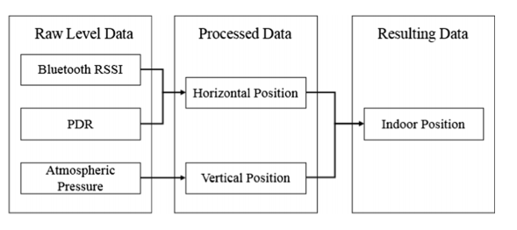
An indoor localization solution using BLE’s RSSI and multiple sensors on a smartphone
Components
BLE
Accelerometer
Magnetic field
barometer
BLE proximity to correct PDR at immediate distance( less than 1m)
determining heading direction based on RSSIs (approaching or moving Magnetic field
2 byte major + 2 byte minor = 32 bit
Flowchart
Horizontal
Vertical

Slide 11
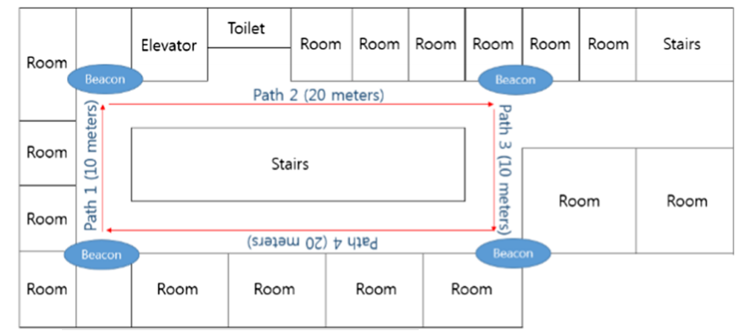
Results
measure the accuracy of the RSSIs
traced movements
obtained atmospheric pressure data barometer
Localization overall error 4.8%

Slide 12
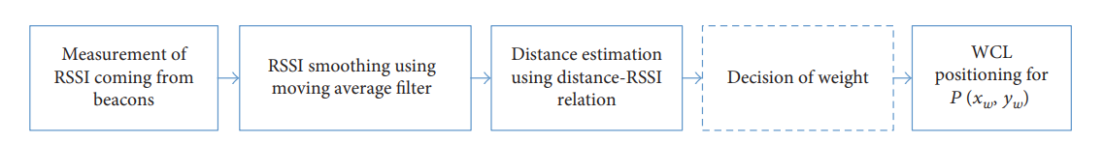
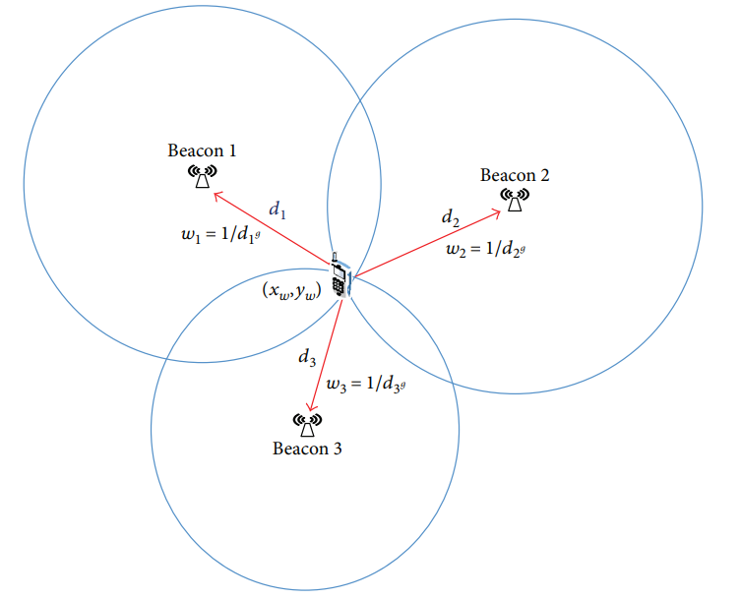
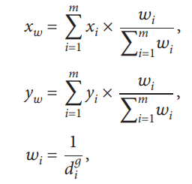
Practical Fingerprinting Localization for Indoor Positioning System Using Beacons
Reduces the number reference points by 42%
Similar error compare to traditional fingerprinting localization method
Weighted Centroid Localization (WCL)
inside the region surrounded by beacons
Near beacon has highest weight

Slide 13
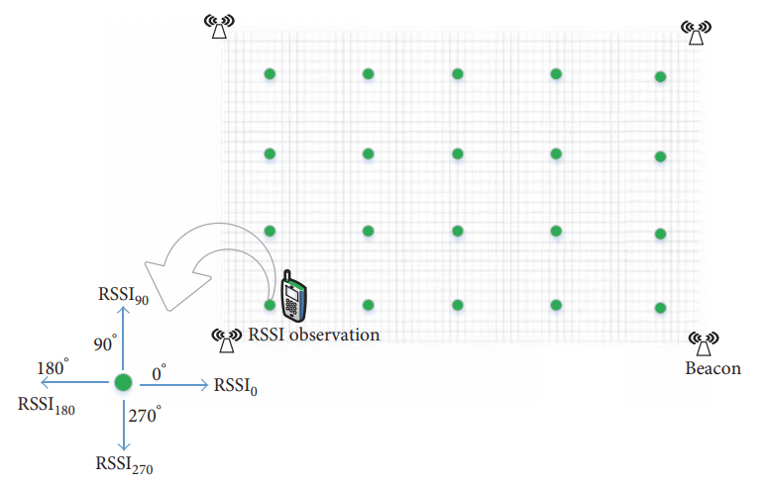
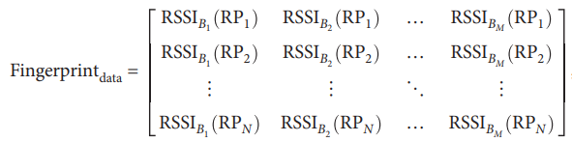

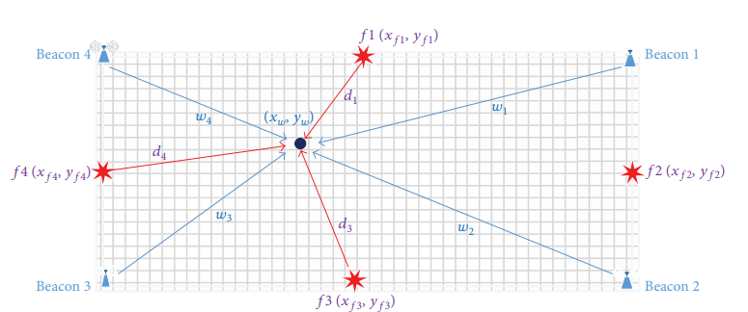
Fingerprinting Localization
does not require line-of-sight
Low Complexity, High Applicability
Position distance at jth reference point :
Least k positioning difference is chosen
inverse of it is assigned as weight to their respective reference points

Slide 14
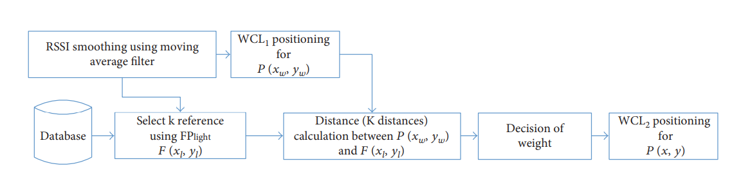
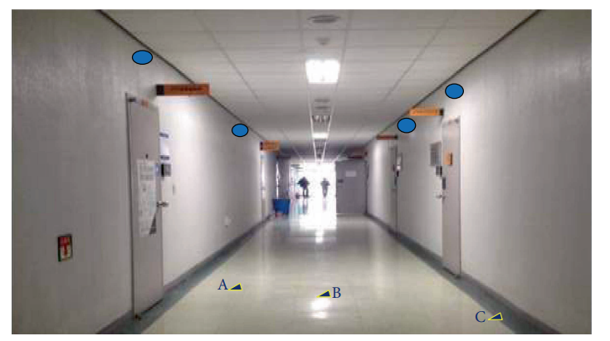
Flowchart
Results
Experiment environment: Corridor

Slide 15
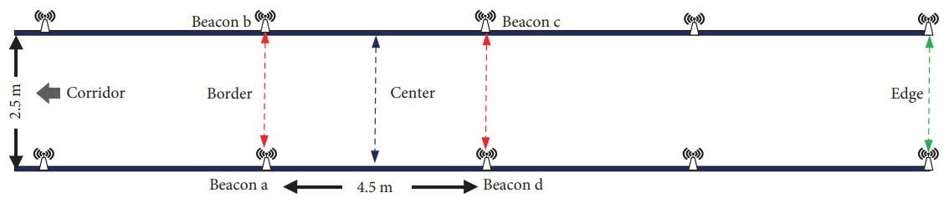
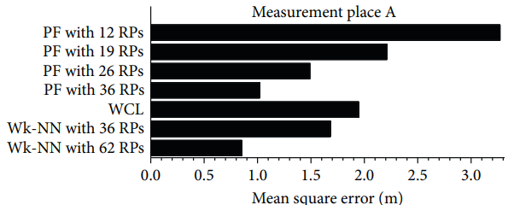
Location regions for measurements
Average location error for different methods (at the edge)

Slide 16
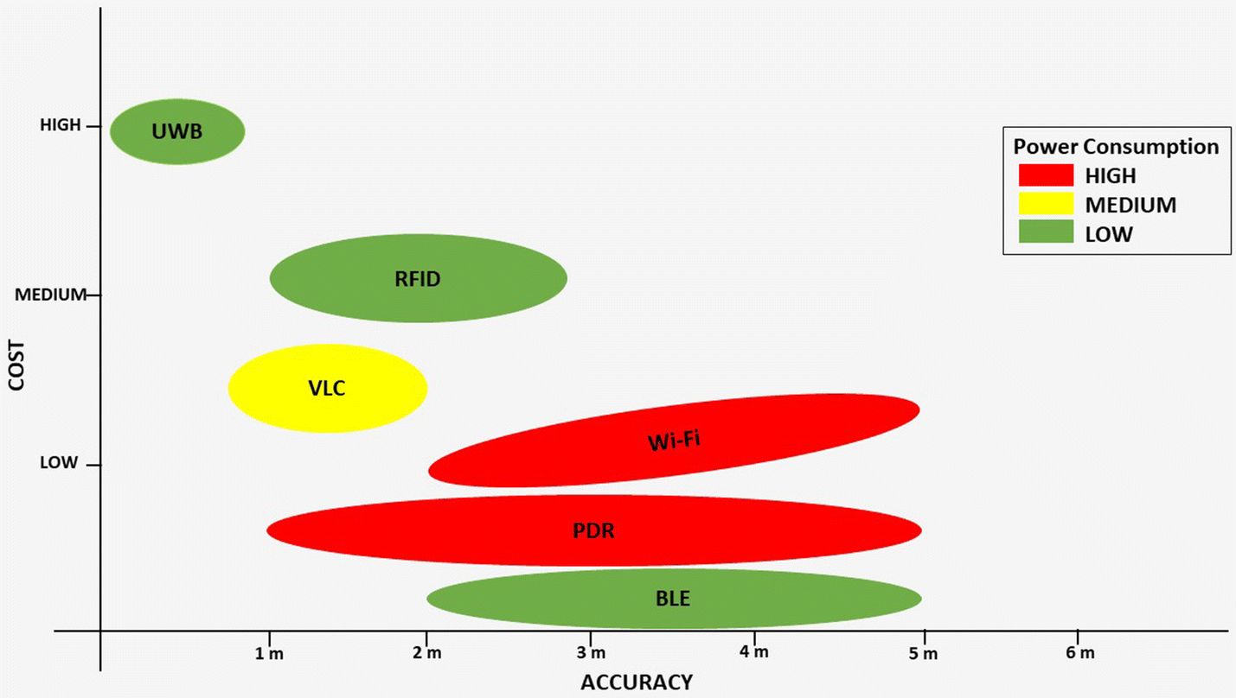
Evaluation Criteria
Accuracy/precision and Cost
Scalability
Geography
Number of users

Slide 17
Robustness
withstand adverse conditions
losses of signal
Usability
preferences of consumers

Slide 18
Thank You!

